Slide 1

Launch your career to new heights!
Career Development Process

Slide 2
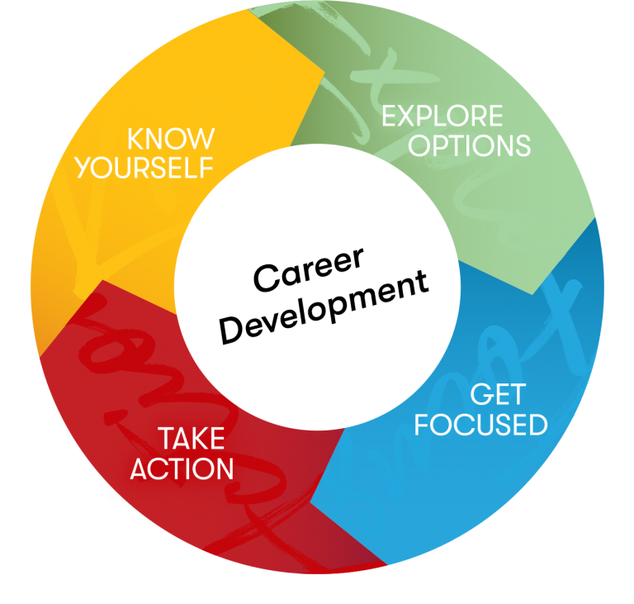
Getting Started

Slide 3

Where do I begin…Know Yourself First!
What gives me the most energy at work?
When do I let my self-belief hold me back?
How can I get feedback and more of it?
Who can offer me a different perspective on my career challenges?
What do I want to be true in 12 months that is not true today?
“How to Become Your Own Career Coach”
Notes:
Reference HBR Article
Create a five-minute mind-map
Understand intent vs. impact
Coach-Yourself Questions (CYQs)
Open
Ownership
One at a time
What gives me the most energy at work?
When do I let my self-belief hold me back?
How can I increase the frequency of the feedback that I get?
Who could offer me a different perspective on my career challenge?
What do I want to be true in 12 months’ time that isn’t true today?
Find your friction
Become your best friend

Slide 4

Explore your Options
Meet with your manager
  Complete a skill assessment
  Identify future interests/positions
Review Career Guide
Schedule exploratory interviews
Select a Mentor

Slide 5

Get Focused
Take ownership of your care
Create/update Individual Development plan (IDP)
Identify the type of responsibilities you love about your job – identify other jobs that include similar work
Schedule regular meetings with impactful network members

Slide 6

Take Action!
Schedule regular meetings with a mentor & manager
Ask for feedback (mgr, peers, etc)
Complete training identified to build/strength necessary skills
Network internally & externally

Slide 7
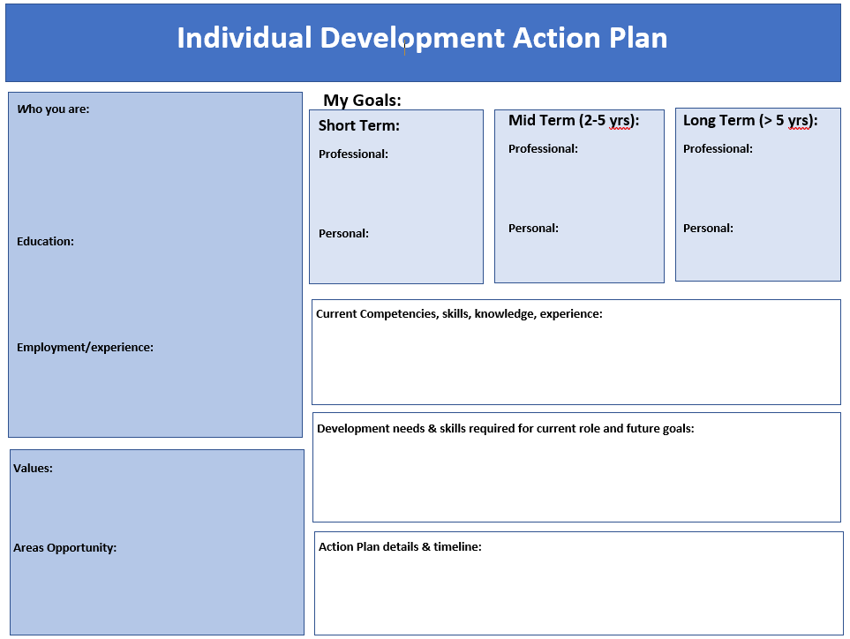
Be sure to complete your IDP by April 1st

Slide 8

eHealth Technologies Learning Library
Operations Career Guide
Director of Talent Development – Laura DiNatale
Your Manager
Mentor
Career Coach
Network
Exploratory Interviews

Slide 9
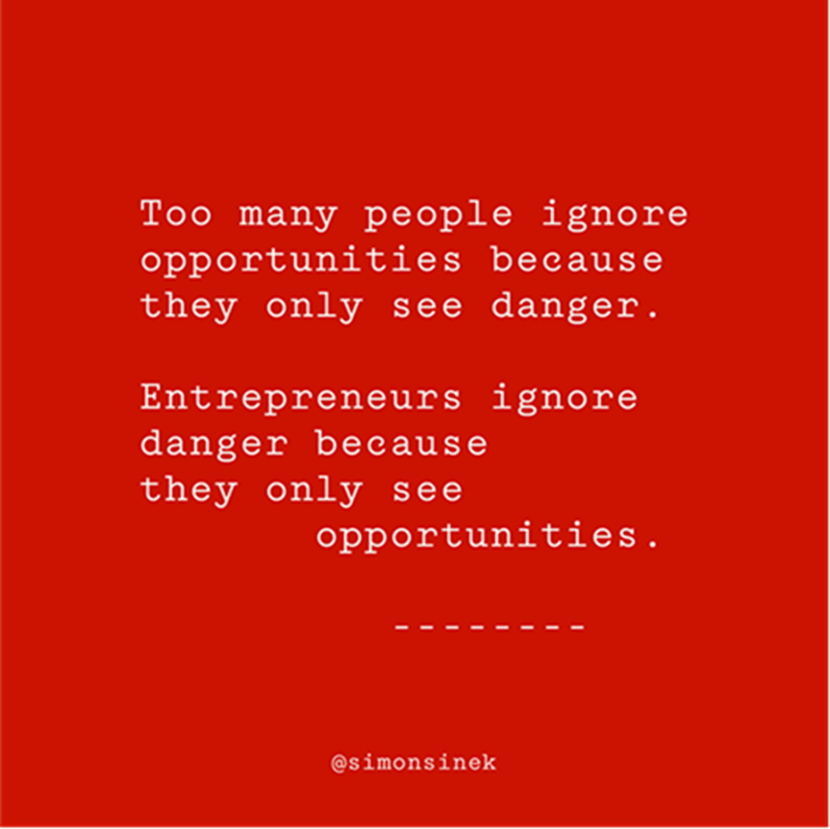
For questions:
contact Laura DiNatale/Director of Talent Development
Visit eHealth Technologies Learning Library at
ehealthtechnologies.info/learning-resources (password: eHealth@home)

